Slide 1

Hypocalcemia in Small Ruminants
Alicia Bays

Slide 2
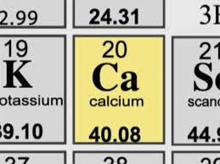
Calcium
5th most abundant element in the body¹
  99% in form of hydroxyapatite in the bone
  Soft tissues
  Extracellular fluid
In blood:
  55% ionized (free) → biologically active form
  40% protein bound
  Rest bound in complexes
Normal level in blood: 8.5-10.0 mg/dl
  slightly higher in younger animals

Slide 3
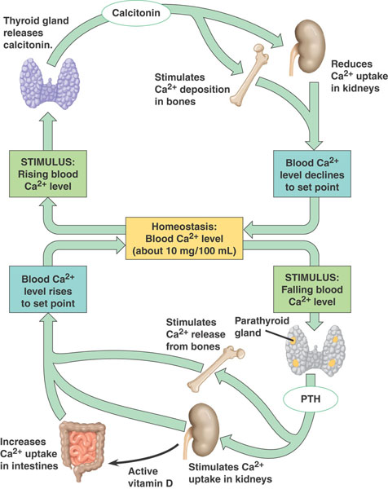
Notes:
Image from: http://students.cis.uab.edu/elo/calcium%20image.jpg

Slide 4
Calcium Regulation
Intestinal Ca absorption increases during gestation to meet fetal needs⁷
  Due to increased vit. D production⁸
Mobilization of calcium from bone increases the first week of lactation → reversible early lactation osteoporosis
Osteoclastic activity returns to normal by one month post partum

Slide 5

Vitamin D
Three intestinal receptor types
  I: numbers decrease with age
  II: increase during pregnancy and lactation
  III: decrease temporarily at parturition
    Evidence of estrogen influence⁸
Goats have higher levels of intestinal receptors than sheep⁸
Changes in sheep occurred in lactation
Increases began in late gestation with goats⁸

Slide 6
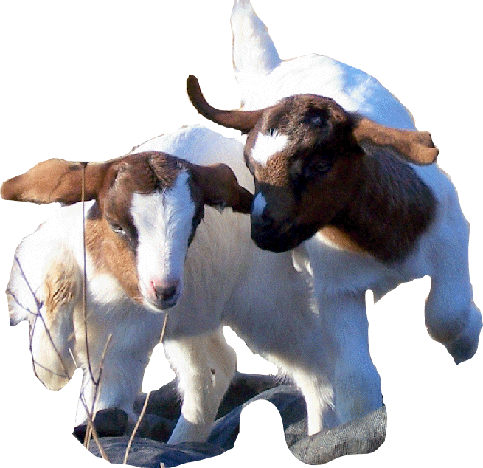
Calcium Requirements⁷
Goats:
  3.5-10 gm/day at end of gestation
  >30 gm/day in lactation
Sheep:
  3-6gm/day
  19 gm/day in lactation

Slide 7
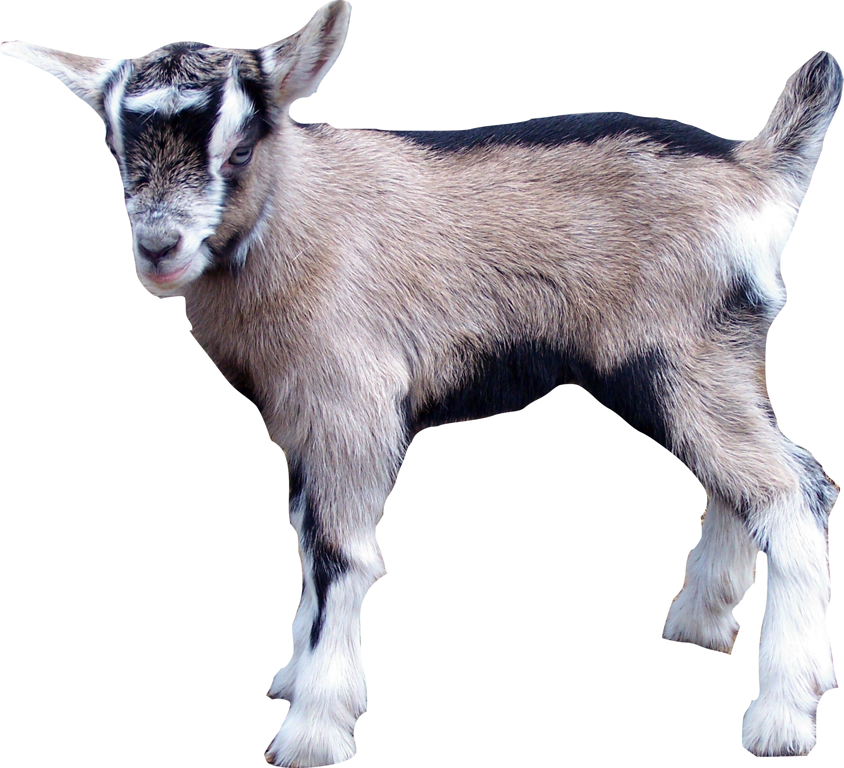
Timing
Fetalplacental vs. milk
High milk production → postpartum hypocalcemia
  Dairy Cows
  Dairy Goats
Large fetal numbers → prepartum hypocalcemia
  Sheep
  Meat Goats

Slide 8
Hypocalcemia in late gestation ewes
Problem in meeting the demands of the fetuses for calcium
Estrogen increases in late gestation → decreases osteoclastic activity¹
Often complicated by pregnancy toxemia

Slide 9
Predisposing factors in sheep
Late gestation (up to 4 weeks prior to lambing)
Older ewes²
Multiple fetuses²
Extreme BCS

Slide 10
Clinical Signs in Sheep
Paresis
Tetany
Muscle tremors
Flaccid paralysis
Bloat
Depression

Slide 11
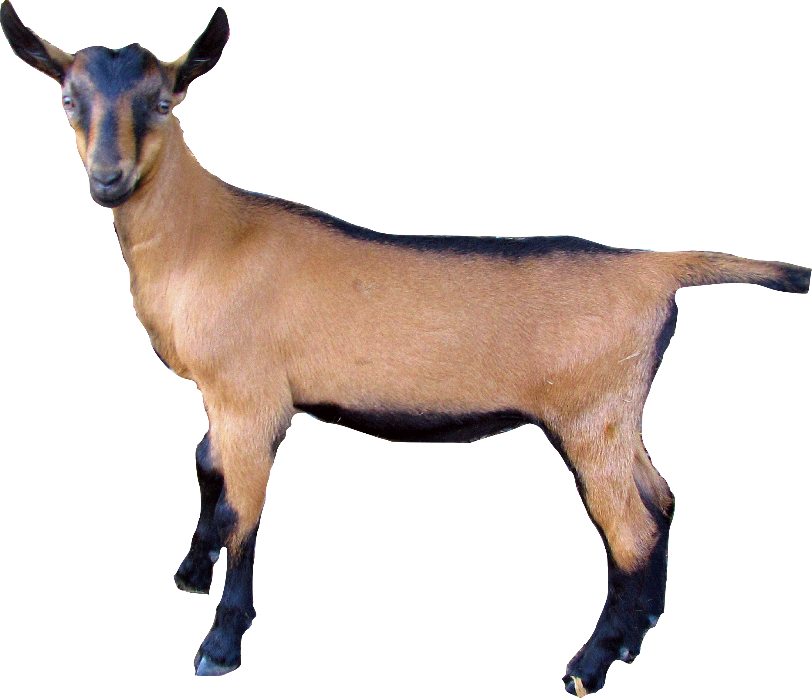
Laboratory changes
Ca levels lower in recumbent animals
Ca levels higher in tetany
Increased PCV with decreased Ca
May have concurrent hypomagnesemia

Slide 12
Clinical Signs in Goats
50% within 3 weeks after kidding, 40% >3 weeks, 10% before kidding⁴
Ataxia
Paresis
Hypothermia
Muscle tremors
Tetany
Bloat
Depression

Slide 13
Effect of hypocalcemia on gut motility
Rumen contractions disappeared before clinical signs of hypocalcemia appeared³
Bloat can be a clinical sign

Slide 14
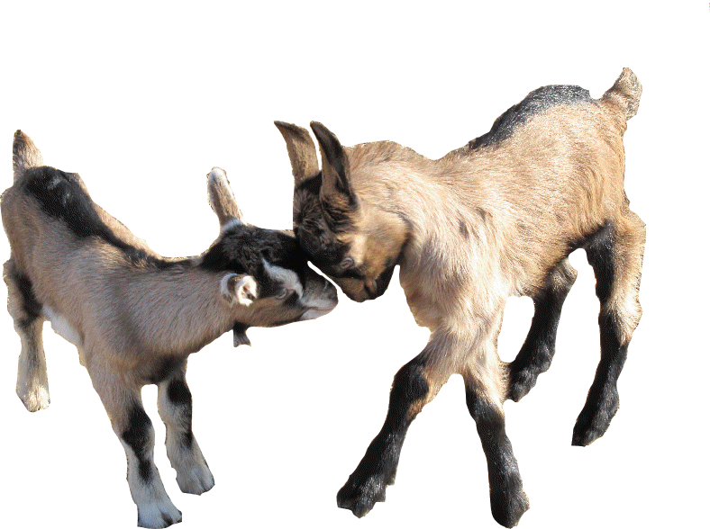
Treatment
50-150 mls of 23% calcium gluconate IV slowly⁶
  Monitor heart rate during administration
Calcium can be added to 1 L of IV fluids
Oral or SQ calcium administration to prevent relapse

Slide 15
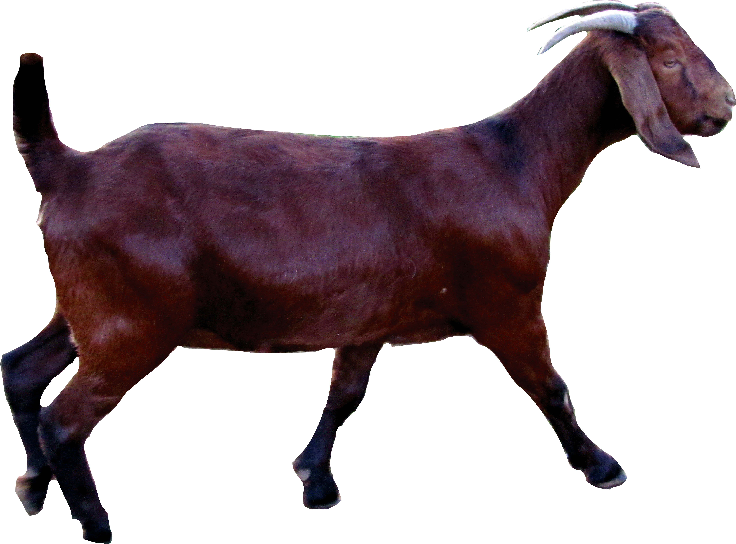
Response to Treatment
25% require more than one treatment²
Lambs were lost in 22% of cases due to premature lambing²

Slide 16
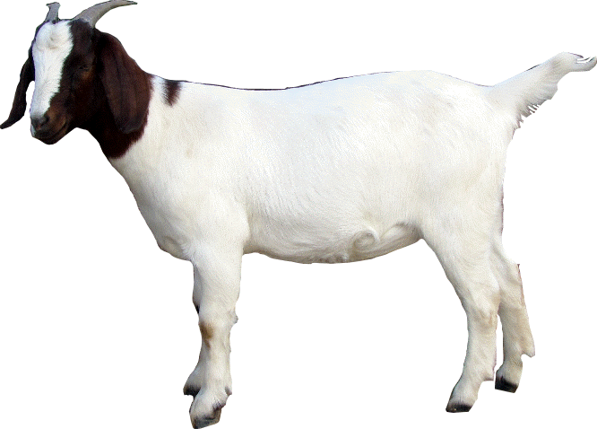
Prevention
Avoid stressors
  Shearing, abrupt feed changes , heavy parasitism, group changes, period of anorexia
Provide high quality feed in late gestation and early lactation
  Maintain 2:1 Calcium:phosphorus ratio
Maintain a normal BCS- overly thin or overweight animals predisposed

Slide 17
Cortisol and Hypoglycemia⁵
Cortisol is released in response to hypocalcemia
Cortisol given exogenously did not cause hypocalcemia
Goats with higher cortisol levels had less severe clinical signs and recovered faster from induced hypocalcemia

Slide 18

Hypocalcemia and Glucose Metabolism¹⁰
Hypocalcemia induces a decline in plasma glucose concentration
suppresses glucose production in pregnant ewes
Cow study: cows with low plasma [Ca2+] were at higher risk of developing bovine ketosis

Slide 19

Endotoxemia in Pregnant Sheep⁹
E. coli endotoxin administered to pregnant ewes
  Hypoglycemia
  Hypocalcemia
  acidosis

Slide 20
Endotoxemia
Activates Immune System
Vascular Damage
Decreased CO and BP
Compensatory sympathetic activation
Decreased tissue perfusion
Lactic acidosis
Cytokines released
Fever
Depression
Hepatic glycogenolysis
Hypocalcemia

Slide 21
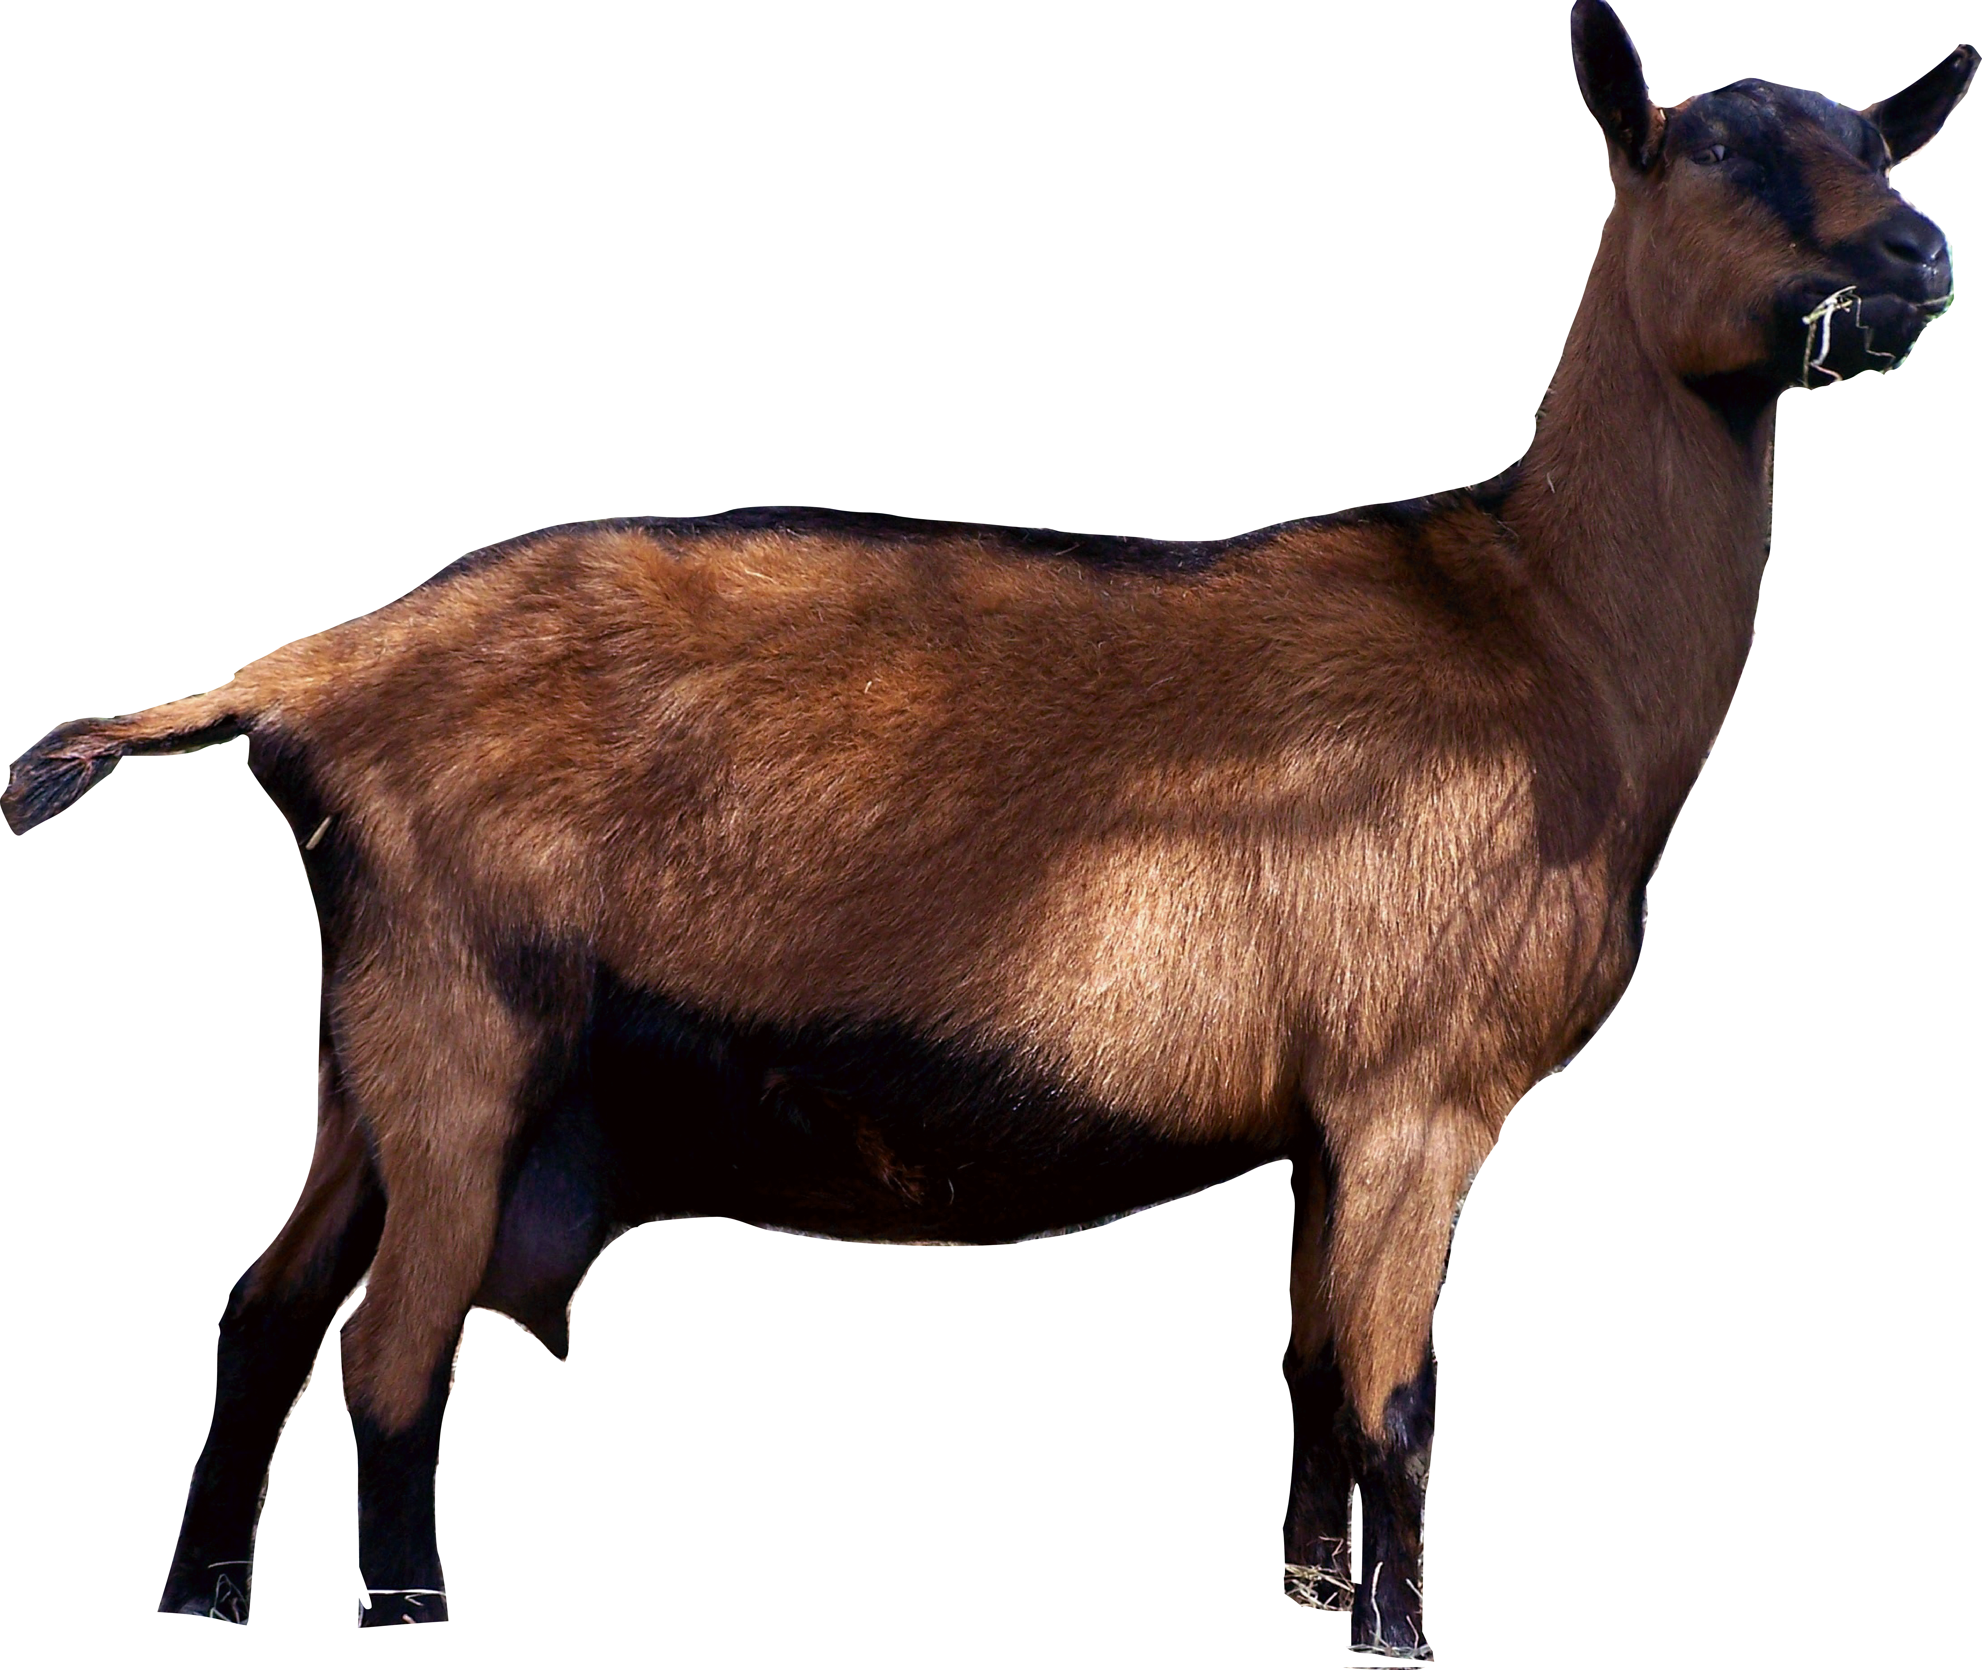
Treatment involves prevention?
Give energy support to prevent progression towards pregnancy toxemia
Many animals can be subclinically ketotic¹¹
Add 50-100 mls 50% dextrose to L of IV fluids

Slide 22
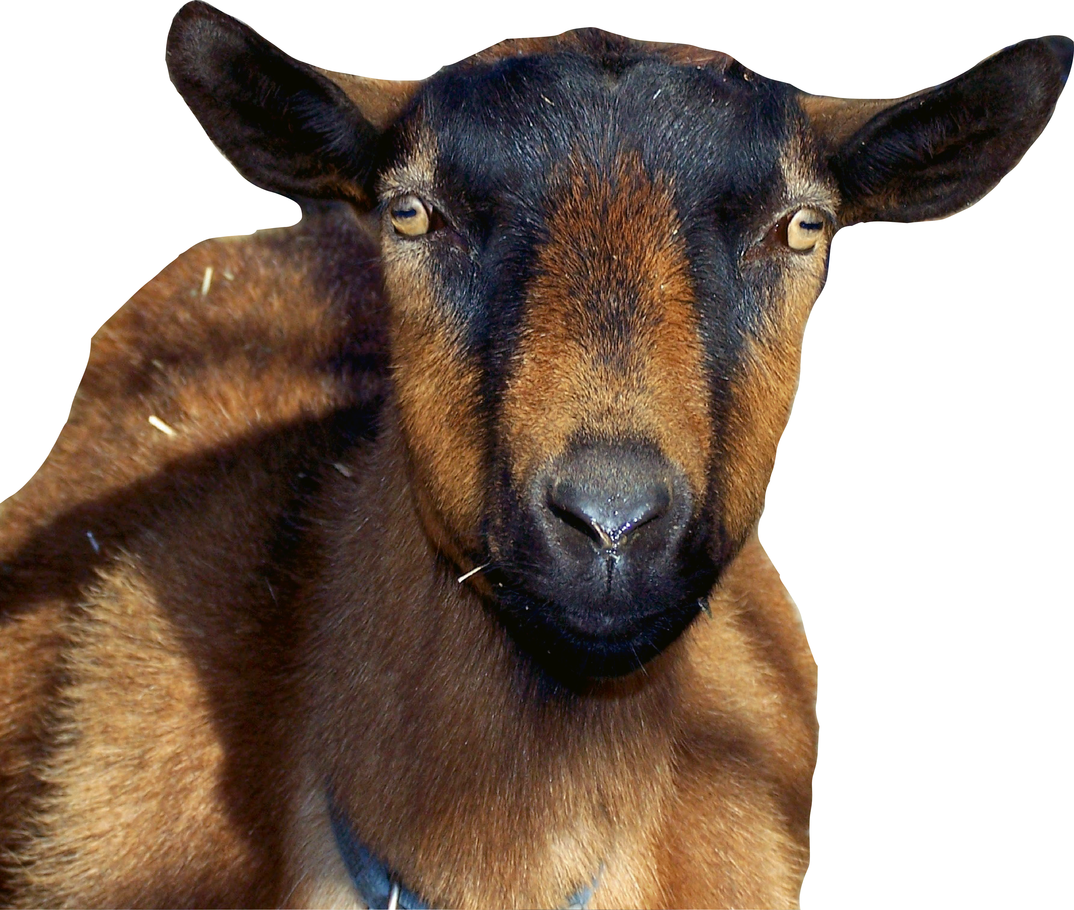
Questions?

Slide 23
References
Bradford, Smith. Large Animal Internal Medicine. Mosby, 2009.
Nosdol G and S Waage. “Hypocalcemia in the ewe”. Nord Vet Med. 1981 Jun-aug; 33(6-8): 310-26.
Huber TL et al. “Effect of hypocalcemia on motility of the ruminant stomach”. American Journal of Veterinary Research. 1981, 42(9): 1488-90.
Oeverby and Oedegaard. “Hypocalcemia in the goat”. Nord Vet Med. 1980 Vol. 92 No.1 pp.21-25.
Horst and Jorgensen. “Elevated plasma cortisol during induced and spontaneous hypocalcemia in ruminants”. http://dx.doi.org/10.3168/jds.S0022-0302(82)82505-8.
Olgivie, Timothy. Large Animal Internal Medicine. First Edition. 1998. Williams and Wilkins.
Liesegang et al. “The effects of first gestation and lactation on bone metabolism in dairy goats and milk sheep”. Bone 38 (2006) 794-802.
Liesegang et al. “Effects of gestation and lactation on Vitamin D receptor amounts in goats and sheep”. Domestic Animal Endocrinology 33 (2007) 190-202.
Naylor and Kronfield. “Relationships between metabolic changes and clinical signs in pregnant sheep given endotoxin”. Can J Vet Res 1986; 50: 402-409.
Schlumbohm and Harmeyer. “Hypocalcemia reduces endogenous glucose production in hyperketonemic sheep”. J Dairy Science. 86:1953-1962. 2003.
Ismail et al. “Metabolic profiles in goat does in late pregnancy with and without subclinical pregnancy toxemia”. Veterinary Clinical Pathology. 37/4 (2008) 434-437.

